Slide 1
Financial Dashboard
-ASTHA SINGH

Slide 2
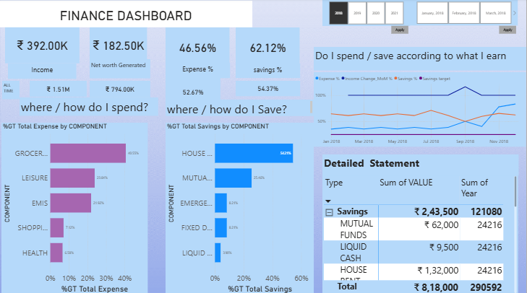

Slide 3
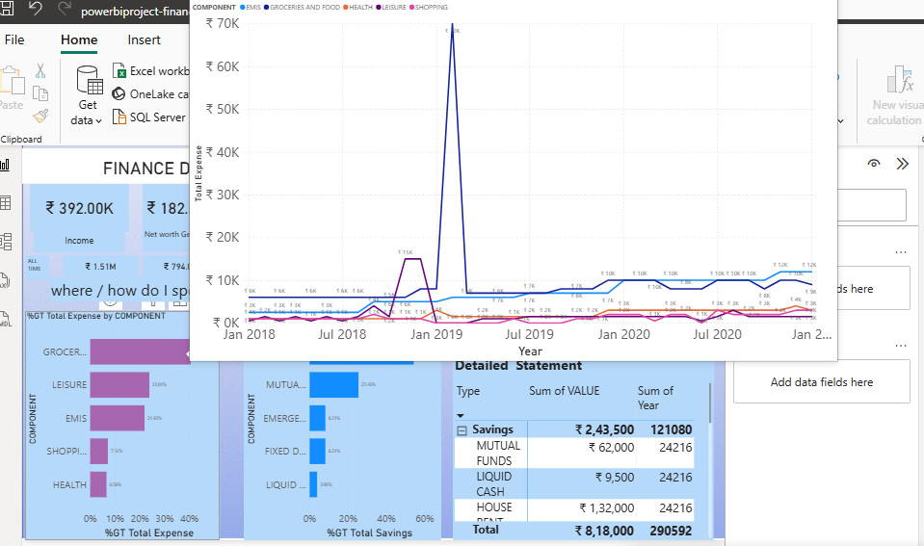

Slide 4
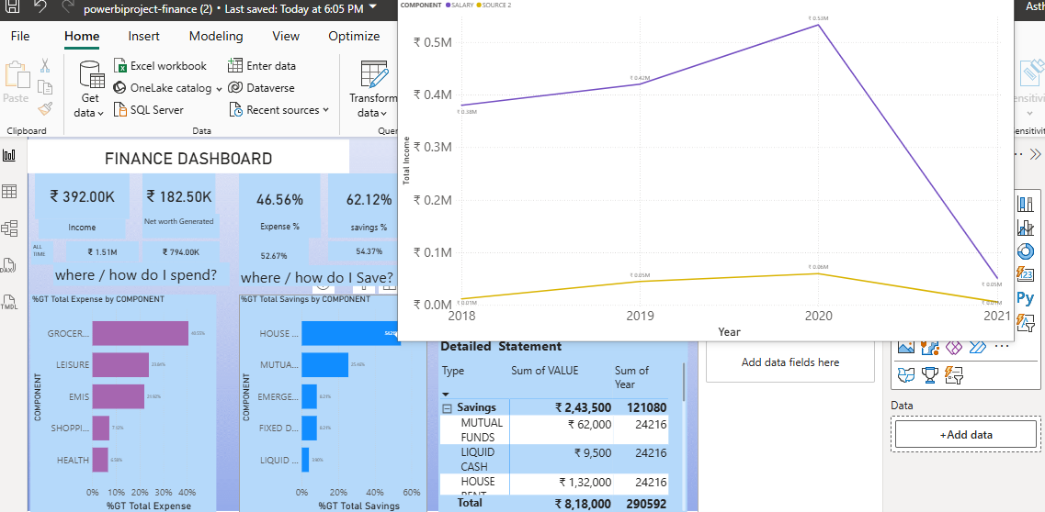

Slide 5
